Slide 1
Welcome! Database Development and Design
Developing and Design of databases using SQL Server

Slide 2

About Me
Education
Bachelor’s degree – FEIT (2008-2013)
Working Experience
Seavus Group (2019 – Ongoing)
NLB Banka (2014-2019)
EduSoft (2013)
Current job position
Database developer at Seavus
Contact mail:
dana.tasevska@seavus.com

Slide 3
Database concepts and usage

Slide 4
Database definition
Database is a container of logically related data and information electronically stored in a computer system.
The purpose of storing data in the DB is: easily stored, modified, protected and analyzed.
DBMS(Database Management System) is software used to manage the database. Users use language to interact with the data in the database. Examples of DBMS: Microsoft SQL Server, Microsoft Access, Oracle…
Two types od DB:
Relational databases – Structured data organized in tables (Popular vendors: SQL Server, Oracle, MySQL)
Non-Relational databases – Non structured data stored in a file (Popular vendors: MongoDB, Cassandra)

Slide 5
Introduction to SSMS

Slide 6
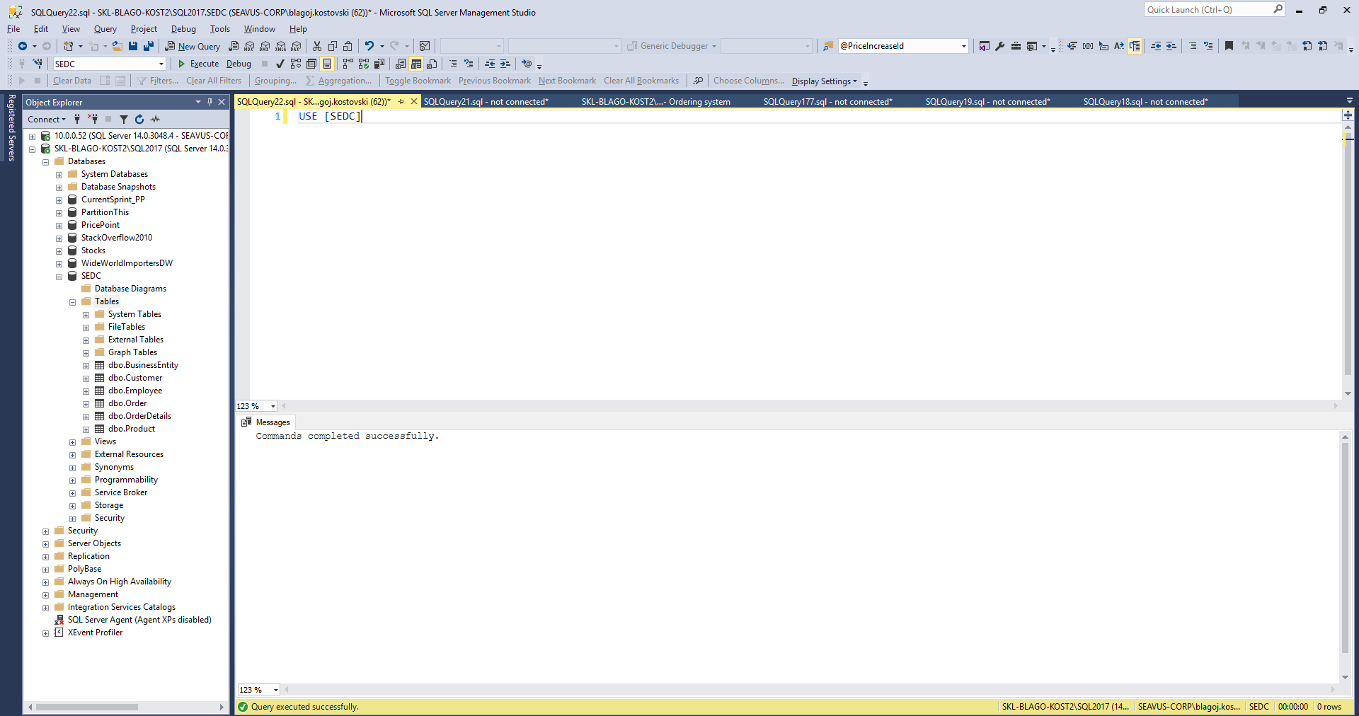

Slide 7
Key terminology

Slide 8
Key database terminology 1/2
Data Definition Language (DDL) is a subset of the Transact-SQL language; it deals with creating database objects like tables, constraints, and stored procedures. The interface used to create these underlying DDL statements is the SSMS user interface.
The six main DDL statements are as follows:
USE: Changes the database context.
CREATE: Creates a SQL Server database object (table, view, or stored procedure).
ALTER: Changes an existing object.
DROP: Removes an object from the database.
TRUNCATE: Removes rows from a table and frees the space used by those rows.
DELETE: Remove rows from a table but does not free the space used by those rows removed.

Slide 9
Key database terminology 2/2
Data Manipulation Language (DML) is the language element that allows you to use the core statements INSERT, UPDATE and DELETE to manipulate data in any SQL Server tables. Core DML statements include the following:
SELECT: Retrieves rows from the database and enables the selection of one or many rows or columns from one or many tables in SQL Server.
INSERT: Adds one or more new rows to a table or a view in SQL Server.
UPDATE: Changes existing data in one or more columns in a table or view.
DELETE: Removes rows from a table or view.

Slide 10
Data types in SQL Server
Each column in a database table is required to have a name and a data type.
SQL data type is an attribute that specifies type of data of any object. Each column, variable and expression has related data type in SQL.
In SQL Server, each column, local variable, expression, and parameter have a related data type. A data type is an attribute that specifies the type of data that the object can hold: integer data, character data, monetary data, date and time data, binary strings, and so on.
Exact numeric | Unicode character strings
Approximate numeric | Binary strings
Date and time | Other data types
Character strings

Slide 11
Data types in SQL Server
Exact numeric
Data type | Range | Storage
bigint | -2^63 (-9,223,372,036,854,775,808) to 2^63-1 (9,223,372,036,854,775,807) | 8 Bytes
int | -2^31 (-2,147,483,648) to 2^31-1 (2,147,483,647) | 4 Bytes
smallint | -2^15 (-32,768) to 2^15-1 (32,767) | 2 Bytes
tinyint | 0 to 255 | 1 Byte
Data type | Range | Storage
Decimal(p,s) | 10^38 +1 to 10^38 – 1 (p-Precision , S-Scale) Example: Decimal(5,2) – max: 999,99 | Depends on Precision
Data type | Range | Storage
Money | -922,337,203,685,477.5808 to 922,337,203,685,477.5807 (-922,337,203,685,477.58 to 922,337,203,685,477.58 ) | 8 bytes
smallmoney | - 214,748.3648 to 214,748.3647 | 4 bytes

Slide 12
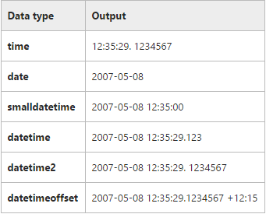
Data types in SQL Server
Approximate Numeric
Date and Time
date
datetimeoffset
datetime2
smalldatetime
datetime
time
n value | Precision | Storage size
1 - 24 | 7 digits | 4 bytes
25-53 | 15 digits | 8 bytes
Data type | Range | Storage
float | - 1.79E+308 to -2.23E-308, 0 and 2.23E-308 to 1.79E+308 | Depends on the value of n
real | - 3.40E + 38 to -1.18E - 38, 0 and 1.18E - 38 to 3.40E + 38 | 4 Bytes

Slide 13
Data types in SQL Server
Character Strings
char
varchar
text
Unicode Character Strings
nchar
nvarchar
Ntext
Other Data Types
Timestamp
XML

Slide 14
CRUD operations
Create, Read, Update, Delete

Slide 15
Create operation
Primary key concept
Short, Not changeable, Incremental, Unique
Identity concept
CREATE TABLE [Customer](
[Id] [int] IDENTITY(1,1) NOT NULL,
[Name] [nvarchar](100) NOT NULL,
[City] [nvarchar](100) NULL,
CONSTRAINT [PK_Customer] PRIMARY KEY CLUSTERED
(
[Id] ASC
))
GO

Slide 16
INSERT operation
Insert new data
Example:
INSERT INTO [TableName] ([Col1],[Col2],...)
VALUES (Value1,Value2,...)
INSERT INTO [Customer] ([Id], [Name], [City])
VALUES (1, 'Vero Skopje', 'Skopje')

Slide 17
READ operation
Read all data in the table
Read only specific columns:
Read specific columns and rows, use filtering:
SELECT * FROM Customer
SELECT ID, Name, City
FROM Customer
SELECT ID, Name, City
FROM Customer
WHERE City = 'Skopje'

Slide 18
UPDATE operation
Update data
Example:
UPDATE [TableName]
SET Col1 = NewValue, Col2 = NewValue2,...
WHERE ColN = oldValue
UPDATE Customer
SET Name = 'Vero Bitola', City = 'Bitola'
WHERE Name = 'Vero Skopje'

Slide 19
DELETE operation
Delete data
Example:
DELETE
FROM [TableName]
WHERE ColN = oldValue
DELETE
FROM Customer
WHERE Name = 'Vero Skopje'

Slide 20
SORTING data
Ordering the results based on specific order
ORDER BY statement
Example:
SELECT *
FROM [TableName]
ORDER BY [ColumnName] ASC\DESC
SELECT *
FROM Employee
ORDER BY FirstName ASC

Slide 21
Combining sets
Union, Union ALL, Intersect

Slide 22
Combining sets - UNION
UNION set operator unifies the results of the two input queries. As a set operator, UNION has an implied DISTINCT property, meaning that it does not return duplicate rows.
Duplicates are eliminated
Pre-requisites
All sets should have same number and order of columns
Columns should be of same or compatible data type
Example:
Set1
Set2
SELECT FirstName,LastName
FROM Employee
UNION
SELECT FirstName,LastName
FROM Employee

Slide 23
Combining sets – UNION ALL
UNION ALL operator unifies the results of the two input queries. As a set operator, UNION ALL doesn’t has an implied DISTINCT property, meaning that it can return duplicate rows.
Duplicates remain
Pre-requisites
All sets should have same number of columns
Columns should be of same or compatible data type
Example:
Set1
Set2
SELECT FirstName,LastName
FROM Employee
UNION ALL
SELECT FirstName,LastName
FROM Employee

Slide 24
Combining sets – INTERSECT
INTERSECT operator returns only distinct rows that are common to both sets. In other words, if a row appears at least once in the first set and at least once in the second set, it will appear once in the result of the INTERSECT operator.
Pre-requisites
All sets should have same number of columns
Columns should be of same or compatible data type
Example:
Set1
Set2
SELECT FirstName,LastName
FROM Employee
WHERE FirstName = 'Aleksandar'
INTERSECT
SELECT FirstName,LastName
FROM Employee
WHERE LastName = 'Nikolovski'

Slide 25
Referential integrity
Foreign keys

Slide 26
Foreign key
A foreign key is a column or combination of columns in one table that serve as a link to look up data in another table.
In the second table, often called a lookup table, the corresponding column or combination of columns have a primary key or unique constraint applied to them, or a unique index.
So a value in the first table may be duplicated, but in the second table where you look up the corresponding value, it must be unique
Example:
ALTER TABLE [dbo].[Order] WITH CHECK
ADD CONSTRAINT [FK_Order_BusinessEntity] FOREIGN KEY([BusinessEntityId])
REFERENCES [dbo].[BusinessEntity] ([Id])
GO

Slide 27
Table constraints
Default, Check, Unique

Slide 28
Table constraints - Default
The least constraining of all the T-SQL table constraints is the default constraint. In fact, you could say default constraints don't really constrain anything at all; they just supply a default value during an INSERT if no other value is supplied
Can be defined during the table creation
Table can be edited later on to support default constraint
Example:
Demo: Session 2 – 02 Default constraints.sql
alter table Product
add constraint DF_Product_Weight
default 100 for [Weight]
GO

Slide 29
Table constraints - Check
With a check constraint, you declare that the values of a column are constrained in some fashion.
The values are already constrained by the data type, so a check constraint adds some additional constraints on the ranges, or set of allowable values.
Example:
Demo: Session 2 – 03 Check constraints.sql
ALTER TABLE [dbo].[Product_test] WITH CHECK
ADD CONSTRAINT CHK_Products_Price
CHECK (price>=0);
GO

Slide 30
Table constraints - UNIQUE
Unique constraints guarantee that no more then one row can have the same value for specific column(s) in the table.
In the real world this constraints are used to prevent storing duplicate data for the same object (e.g. Table used to store the product can not have the same product inserted twice)
Example:
Demo: Session 2 – 04 Unique constraints.sql
ALTER TABLE [dbo].[Product] WITH CHECK
ADD CONSTRAINT UC_Code UNIQUE (Code)
GO

Slide 31
Join types
Inner, Left, Right, Cross

Slide 32
Join types
Often, data that you need to query is spread across multiple tables. The more normalized the environment is, the more tables you usually have.
The tables are usually related through keys, such as a foreign key in one side and a primary key in the other. Then you can use joins to query the data from the different tables and match the rows that need to be related.
This lesson covers the different types of joins that T-SQL supports:
Cross
Inner
Outer (Left, Right)

Slide 33
Join types – Inner join
With an inner join, you can match rows from two tables based on a predicate—usually one that compares a primary key value in one side to a foreign key value in another side.
Inner join returns only matching rows - rows that exists in both tables
Table A
Table B
M rows
N rows

Slide 34
Join types – Outer join
With outer joins, you can request to preserve all rows from one or both sides of the join, never mind if there are matching rows in the other side based on the ON predicate.
Types:
LEFT (OUTER) JOIN RIGHT (OUTER) JOIN FULL (OUTER) JOIN
Table A
Table B
Table A
Table B
Table A
Table B

Slide 35
Grouping functions
With grouped queries, you can arrange the rows you’re querying in groups and apply data analysis computations like aggregate functions against those groups.
A query becomes a grouped query when you use a group function, a GROUP BY clause, or both.
A query that invokes a group function but doesn’t have an explicit GROUP BY clause arranges all rows in one group. Consider the following query as an example:
SELECT COUNT(*) as Total
FROM dbo.Employee
SELECT Gender, COUNT(*) as Total
FROM dbo.Employee
GROUP BY Gender

Slide 36
Filtering by grouped data
HAVING operator

Slide 37
Grouping functions – filtering by grouped data
Many often we need to perform search operations on already aggregated data
WHERE expression filter the resultset before grouping
HAVING operator is used to filter data after grouping
example:
SELECT Column1, fn(ColumnN)
FROM Table1
WHERE ColumnN condition
GROUP BY Column1
HAVING fn(ColumnN) condition
SELECT BusinessEntityId, SUM(TotalPrice) as Total
FROM dbo.[Order]
WHERE CustomerId < 20
GROUP BY BusinessEntityId
HAVING SUM(TotalPrice) > 628920

